Slide 1
UNIT 1
DIMENSIONS AND SCALES
ENGINEERING GRAPHICS By Phull & Sandhu

Slide 2
Dividing a Line into equal parts
O
M
N
ENGINEERING GRAPHICS By Phull & Sandhu

Slide 3
Dividing a Line into Proportional parts
6
C
5
4
3
2
1:2:3
1
A
B
ENGINEERING GRAPHICS By Phull & Sandhu

Slide 4
Dimensioning
A dimension is a numerical value or values provided in appropriate units of measure and used to define form, size, orientation of location of a feature or part.
Elements of Dimensions
Projection or Extension Lines
Leader Line
Dimension line termination and origin
The value(dimension itself)
ENGINEERING GRAPHICS By Phull & Sandhu

Slide 5
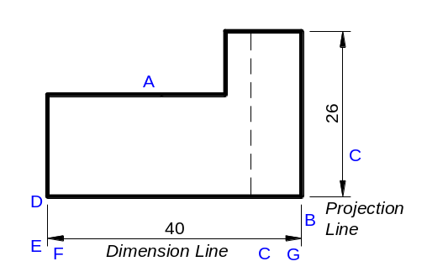
Elements of Dimensioning
Projection or Extension Lines
Gap of 1mm to 1.5 mm
Leader Line
ENGINEERING GRAPHICS By Phull & Sandhu

Slide 6
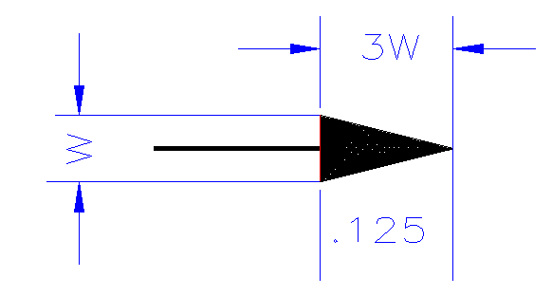
Elements of Dimensioning
Dimension line termination and origin
Open
Closed
Closed And filled
Oblique stroke 45⁰
Circle
ENGINEERING GRAPHICS By Phull & Sandhu

Slide 7
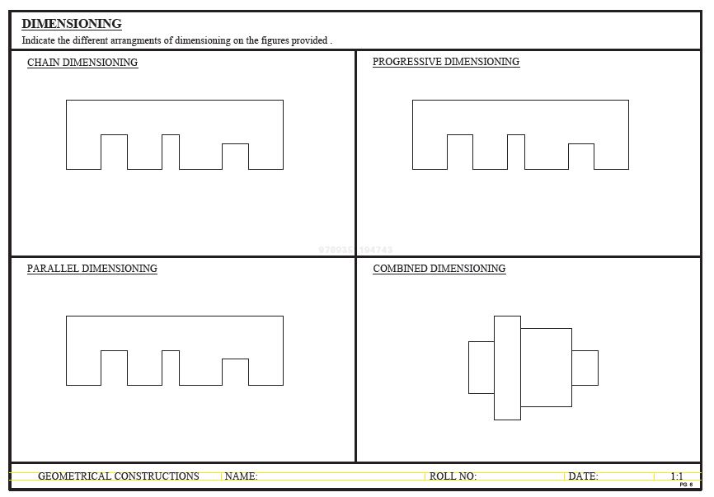
Arrangement of Dimensioning
ENGINEERING GRAPHICS By Phull & Sandhu

Slide 8
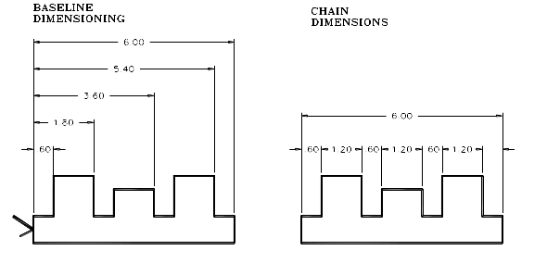
Parallel Dimensioning
Chain Dimensioning

Slide 9
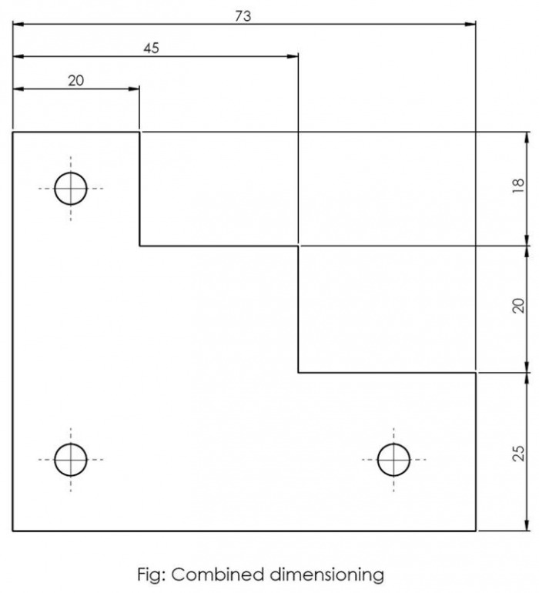
Combined Dimensioning

Slide 10
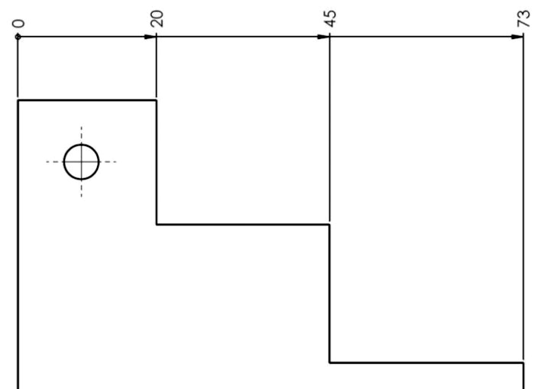
Progressive Dimensioning

Slide 11
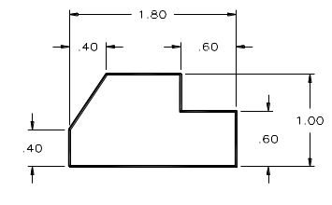
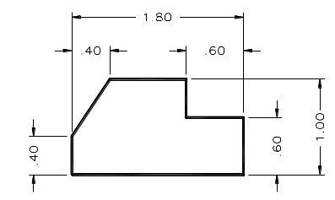
Dimension Styles
Unidirectional dimensions are read from the lower left corner of the sheet
Aligned dimensions align with individual dimension lines.

Slide 12
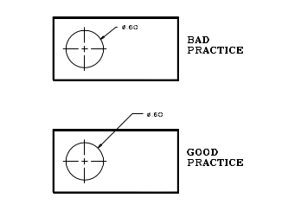
1. Avoid placing dimensions on the part (inside of the view).

Slide 13
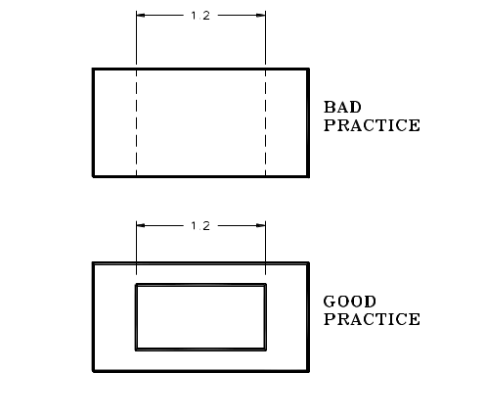
2. Avoid dimensioning to hidden features
There is one exception:……
When the hidden line is a finished (√) surface

Slide 14
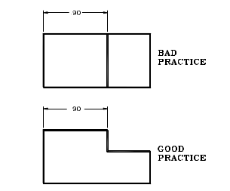
3. Always place dimensions where the characteristic shape is shown in the most descriptive view

Slide 15
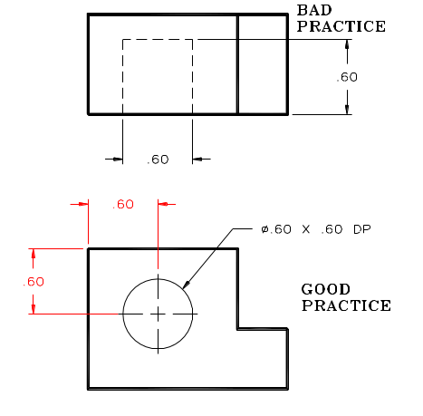
4. Always dimension holes in their circular view with the Ø. Specify special features (hole types) with a note.
Also: Remember to locate hole position with ordinate dimensions to hole centers

Slide 16
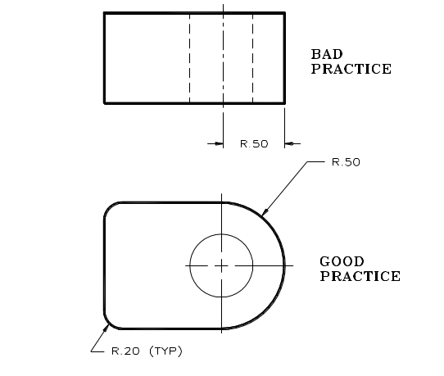
5. Dimension rounded corners and arc features as radii where they appear in their rounded view.

Slide 17
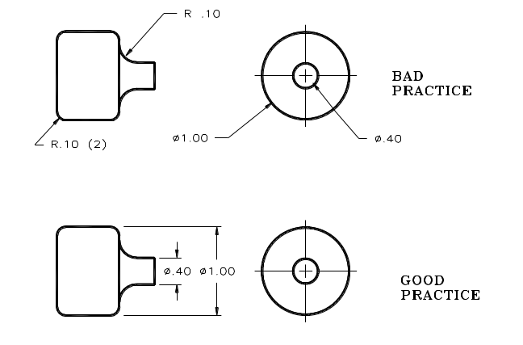
6. Dimension cylinders in their rectangular view with a diameter symbol….Ø.

Slide 18
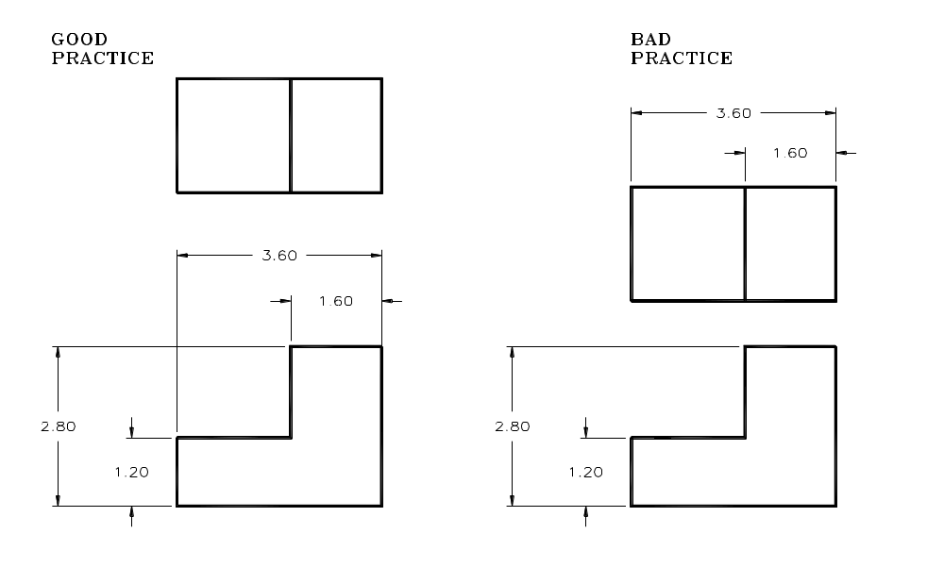
7. Keep dimensions between views whenever possible .

Slide 19
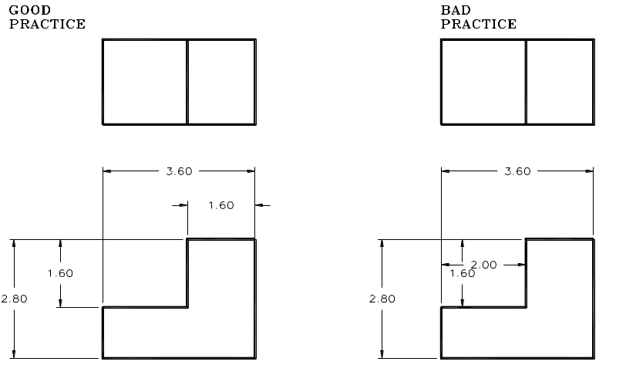
8. Extension lines may cross each other and over other lines on the part, but dimension lines should never be crossed. (Hint no “arrow-headed” lines can cross “arrow-headed” lines)

Slide 20
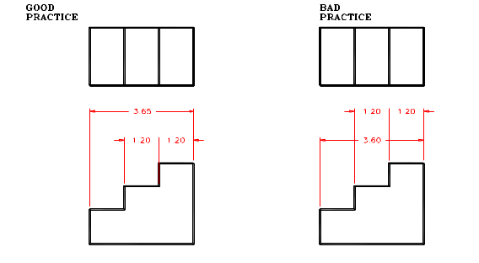
9. The overall dimension should always be given. It should be placed outside of smaller dimensions and be the farthest from the part.

Slide 21
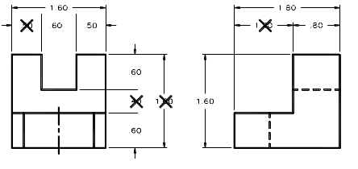
10. Do not duplicate dimensions and avoid using unnecessary or superfluous dimensions

Slide 22
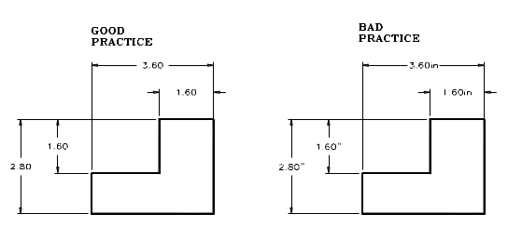
11. When all of the dimensions are expressed as inches. DO NOT use inch marks ('') or the abbreviation (.in)

Slide 23
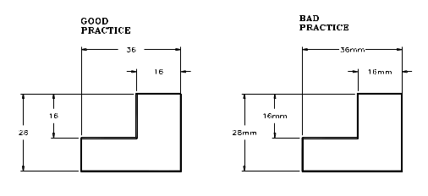
12. For metric drawings, omit the use of the millimeter (mm) notation following the numeral, as millimeters are the default units.

Slide 24
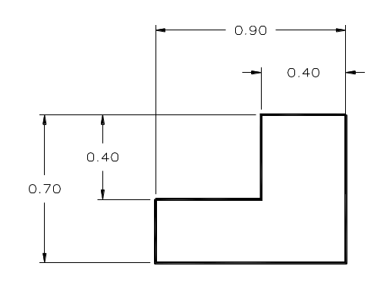
13. For metric dimensions less than 1 mm DO place a zero in front of the decimal point.

Slide 25
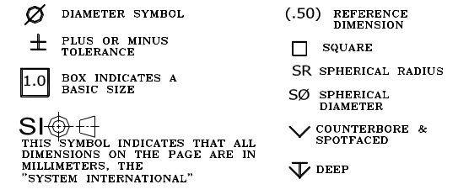
14. Conserve space and time by using abbreviations and standardized symbols whenever possible.

Slide 26
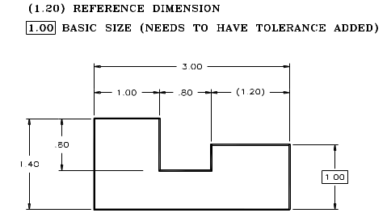
15. Reference dimensions should be placed in parenthesis or should include the abbreviation “REF”. Basic sizes (to be toleranced) should be placed inside of a rectangular box

Slide 27
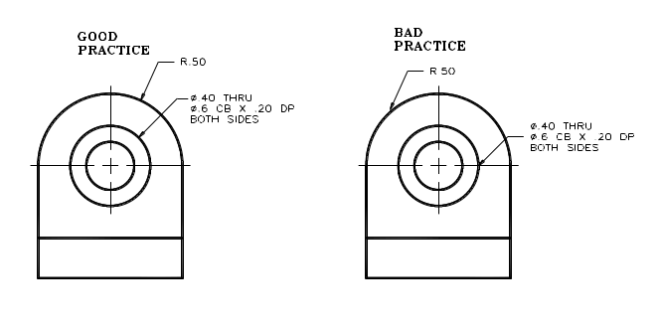
16. Extend leaders from the first or last word in a note. Point them toward (but not touch) the center of the circular features that they are specifying.

Slide 28
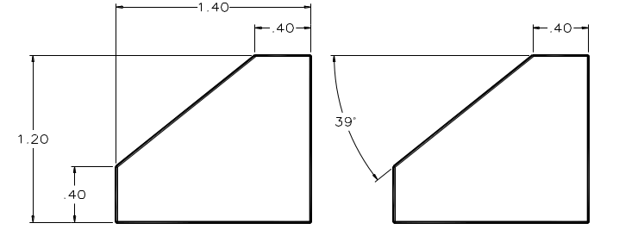
Angular features:
Dimension angular features with either:
X,Y coordinate location or Vertex location & degrees

Slide 29
A short review on Dimension “elements”
What is…
  an Extension line ?
  an Extension line gap ?
  a Dimension line ?
  a Dimension numeral ?
  a leader ?
What size…
  Is an Arrowhead ?

Slide 30
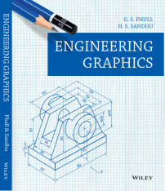
SCALES
DIMENSIONS OF LARGE OBJECTS MUST BE REDUCED TO ACCOMMODATE
ON STANDARD SIZE DRAWING SHEET.THIS REDUCTION CREATES A SCALE
OF THAT REDUCTION RATIO, WHICH IS GENERALLY A FRACTION..
SUCH A SCALE IS CALLED REDUCING SCALE
AND
THAT RATIO IS CALLED REPRESENTATIVE FACTOR.
SIMILARLY IN CASE OF TINY OBJECTS DIMENSIONS MUST BE INCREASED
FOR ABOVE PURPOSE. HENCE THIS SCALE IS CALLED ENLARGING SCALE.
HERE THE RATIO CALLED REPRESENTATIVE FACTOR IS MORE THAN UNITY.
FOR FULL SIZE SCALE
R.F.=1 OR ( 1:1 )
MEANS DRAWING
& OBJECT ARE OF
SAME SIZE.
Other RFs are described
as
1:10, 1:100,
1:1000, 1:1,00,000
ENGINEERING GRAPHICS By Phull & Sandhu

Slide 31
SCALES
USE FOLLOWING FORMULAS FOR THE CALCULATIONS IN THIS TOPIC.
DIMENSION OF DRAWING
A
DIMENSION OF OBJECT
REPRESENTATIVE FACTOR (R.F.) =
LENGTH OF DRAWING
=
ACTUAL LENGTH
AREA OF DRAWING
B
=
V
ACTUAL AREA
LENGTH OF SCALE = R.F. X MAX. LENGTH TO BE MEASURED
ENGINEERING GRAPHICS By Phull & Sandhu

Slide 32
BE FRIENDLY WITH THESE UNITS.
1 KILOMETRE
1 HECTOMETRE
1 DECAMETRE
1 METRE
1 DECIMETRE
1 CENTIMETRE
= 10 HECTOMETRES
= 10 DECAMETRES
= 10 METRES
= 10 DECIMETRES
= 10 CENTIMETRES
= 10 MILIMETRES
TYPES OF SCALES:
PLAIN SCALES ( FOR DIMENSIONS UP TO SINGLE DECIMAL)
DIAGONAL SCALES ( FOR DIMENSIONS UP TO TWO DECIMALS)
VERNIER SCALES ( FOR DIMENSIONS UP TO TWO DECIMALS)
COMPARATIVE SCALES ( FOR COMPARING TWO DIFFERENT UNITS)
SCALE OF CORDS ( FOR MEASURING/CONSTRUCTING ANGLES)
ENGINEERING GRAPHICS By Phull & Sandhu

Slide 33
PLAIN SCALE
PLAIN SCALE:-This type of scale represents two units or a unit and it’s sub-division.
PROBLEM NO.1:- Draw a scale 1 cm = 1m to read decimeters, to measure maximum distance of 6 m. Show on it a distance of 4 m and 6 dm.
CONSTRUCTION:-
DIMENSION OF DRAWING
a) Calculate R.F.=
DIMENSION OF OBJECT
R.F.= 1cm/ 1m = 1/100
Length of scale = R.F. X max. distance
= 1/100 X 600 cm
= 6 cm
ENGINEERING GRAPHICS By Phull & Sandhu

Slide 34
PLAIN SCALE
Draw a line 6 cm long and divide it in 6 equal parts. Each part will represent larger division unit.
Sub divide the first part which will represent second unit or fraction of first unit.
Place ( 0 ) at the end of first unit. Number the units on right side of Zero and subdivisions on left-hand side of Zero. Take height of scale 5 to 10 mm for getting a look of scale.
After construction of scale mention it’s RF and name of scale as shown.
Show the distance 4 m 6 dm on it as shown.
ENGINEERING GRAPHICS By Phull & Sandhu

Slide 35
PLAIN SCALE
4 M 6 DM
10
0
1
2
3
4
5
METERS
DECIMETERS
R.F. = 1/100
PLANE SCALE SHOWING METERS AND DECIMETERS.
ENGINEERING GRAPHICS By Phull & Sandhu

Slide 36
PLAIN SCALE
PROBLEM NO.2:- In a map a 36 km distance is shown by a line 45 cm long. Calculate the R.F. and construct a plain scale to read kilometers and hectometers, for max. 12 km. Show a distance of 8.3 km on it.
Calculate R.F.
R.F.= 45 cm/ 36 km
= 45/ 36 . 1000 . 100
= 1/ 80,000
Length of scale = R.F. X max. distance
= 1/ 80000 X12 km
= 15 cm
ENGINEERING GRAPHICS By Phull & Sandhu

Slide 37
PLAIN SCALE
8KM 3HM
10
5
0
1
2
3
4
5
6
7
8
9
10
11
KILOMETERS
HECTOMETERS
R.F. = 1/80,000
PLANE SCALE SHOWING KILOMETERS AND HECTOMETERS
ENGINEERING GRAPHICS By Phull & Sandhu

Slide 38
PLAIN SCALE
PROBLEM NO.3:- The distance between Jalandhar and Yamunanagar stations is 240 km. A passenger train covers this distance in 8 hours. Construct a plain scale to measure time up to a single minute. RF is 1/200,000. Indicate the distance travelled by train in (1) 29 minutes (2) 41 minutes
ENGINEERING GRAPHICS By Phull & Sandhu

Slide 39
We have seen that the plain scales give only two dimensions, such as a unit and it’s subunit or it’s fraction.
The diagonal scales give us three successive dimensions
that is a unit, a subunit and a subdivision of a subunit.
X
Y
10’
10
9’
9
Consider two similar triangles XYZ and 7’ 7Z,
we have 7Z / YZ = 7’7 / XY (each part being one unit)
Now 7Z = 0.7 YZ
Means 7’ 7 = 0.7 x X Y = 0.7 XY
8
DIAGONAL
SCALE
8’
7’
7
6’
6
5’
5
4’
4
3’
3
2’
2
1’
1
Z
ENGINEERING GRAPHICS By Phull & Sandhu

Slide 40
PROBLEM NO. 4 : The distance between Delhi and Agra is 200 km.
In a railway map it is represented by a line 5 cm long. Find it’s R.F.
Draw a diagonal scale to show single km. And maximum 600 km.
Indicate on it following distances. 1) 222 km 2) 336 km 3) 459 km 4) 569 km
DIAGONAL
SCALE
SOLUTION STEPS: RF = 5 cm / 200 km = 1 / 40, 00, 000
Length of scale = 1 / 40, 00, 000 X 600 X 10⁵ = 15 cm
Draw a line 15 cm long. It will represent 600 km.Divide it in six equal parts.( each will represent 100 km.)
Divide first division in ten equal parts.Each will represent 10 km.Draw a line upward from left end and
mark 10 parts on it of any distance. Name those parts 0 to 10 as shown.Join 9th sub-division of horizontal scale
with 10th division of the vertical divisions. Then draw parallel lines to this line from remaining sub divisions and
complete diagonal scale.
569 km
459 km
336 km
222 km
10
9
8
7
6
5
4
3
2
1
0
KM
KM
100
50
0
100
200
300
400
500
KM
R.F. = 1 / 40,00,000
DIAGONAL SCALE SHOWING KILOMETERS.
ENGINEERING GRAPHICS By Phull & Sandhu

Slide 41
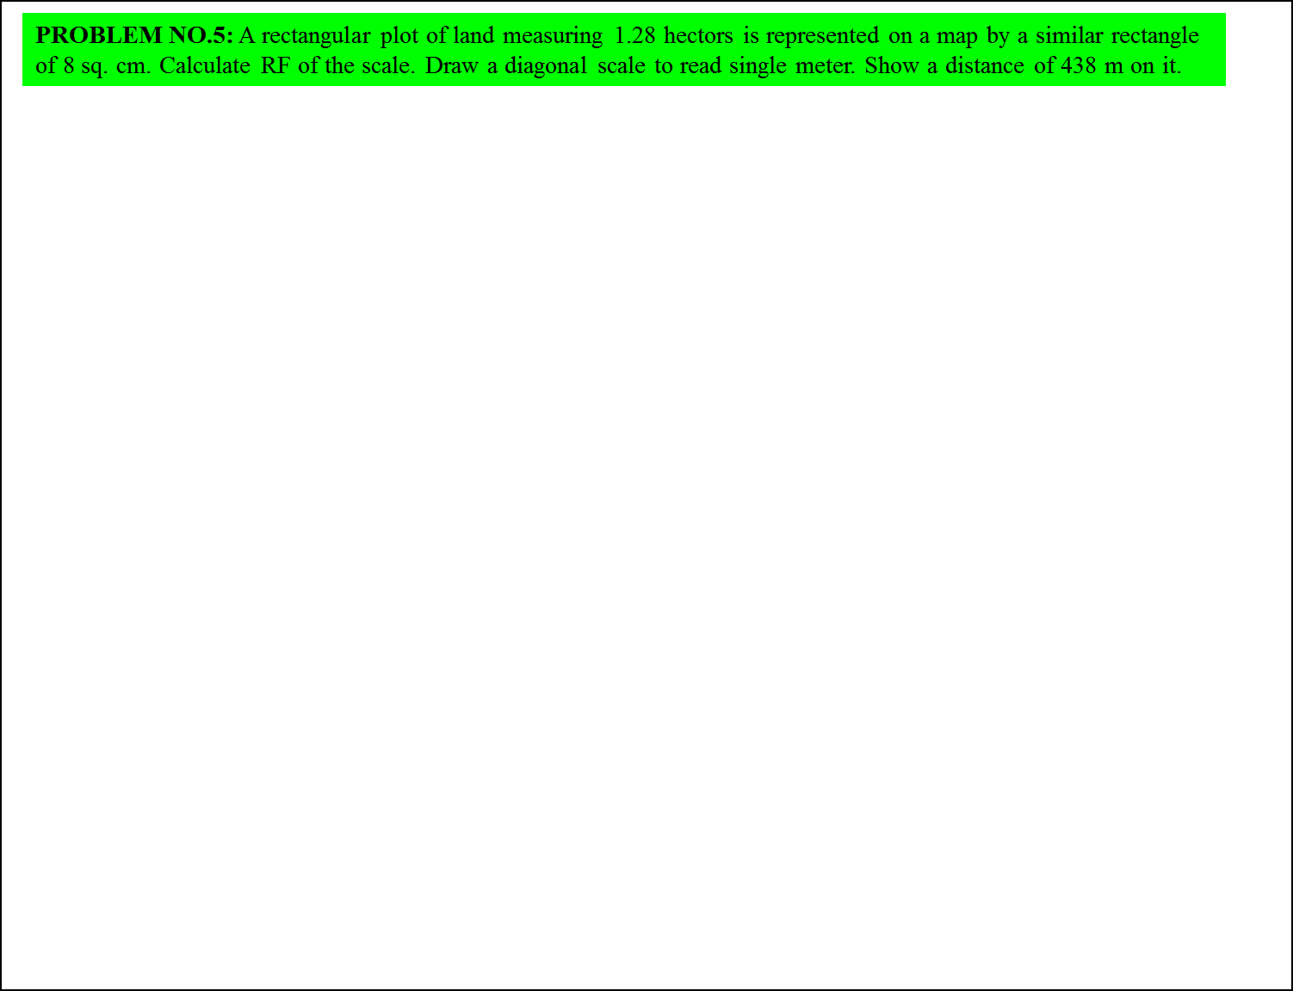
SOLUTION STEPS:
1 hector = 10, 000 sq. meters
1.28 hectors = 1.28 X 10, 000 sq. meters
= 1.28 X 10⁴ X 10⁴ sq. cm
8 sq. cm area on map represents
= 1.28 X 10⁴ X 10⁴ sq. cm on land
1 cm sq. on map represents
= 1.28 X 10 ⁴ X 10⁴ / 8 sq cm on land
1 cm on map represent
=
DIAGONAL
SCALE
Draw a line 15 cm long.
It will represent 600 m.Divide it in six equal parts.
( each will represent 100 m.)
Divide first division in ten equal parts.Each will
represent 10 m.
Draw a line upward from left end and
mark 10 parts on it of any distance.
Name those parts 0 to 10 as shown.Join 9th sub-division
of horizontal scale with 10th division of the vertical divisions.
Then draw parallel lines to this line from remaining sub divisions
and complete diagonal scale.
1.28 X 10 ⁴ X 10⁴ / 8
cm
= 4, 000 cm
1 cm on drawing represent 4, 000 cm, Means RF = 1 / 4000
Assuming length of scale 15 cm, it will represent 600 m.
438 meters
10
9
8
7
6
5
4
3
2
1
0
M
M
100
50
0
100
200
300
400
500
M
R.F. = 1 / 4000
DIAGONAL SCALE SHOWING METERS.
ENGINEERING GRAPHICS By Phull & Sandhu

Slide 42
PROBLEM NO.6:. Draw a diagonal scale of R.F. 1: 2.5, showing centimeters
and millimeters and long enough to measure up to 20 centimeters. Show the distance 13.4 cm on it
SOLUTION STEPS:
R.F. = 1 / 2.5
Length of scale = 1 / 2.5 X 20 cm.
= 8 cm.
1.Draw a line 8 cm long and divide it in to 4 equal parts.
(Each part will represent a length of 5 cm.)
2.Divide the first part into 5 equal divisions.
(Each will show 1 cm.)
3.At the left hand end of the line, draw a vertical line and
on it step-off 10 equal divisions of any length.
4.Complete the scale as explained in previous problems.
Show the distance 13.4 cm on it.
DIAGONAL
SCALE
13 .4 CM
10
9
8
7
6
5
4
3
2
1
0
MM
CM
5
4
3
2
1
0
5
10
15
CENTIMETRES
R.F. = 1 / 2.5
DIAGONAL SCALE SHOWING CENTIMETERS.
ENGINEERING GRAPHICS By Phull & Sandhu

